Slide 1



Seaborn: Statistical data visualization
AFRICA DATA SCHOOL
www.africadataschool.com

Slide 2
Seaborn is a Python data visualization library based on Matplotlib . It provides a high-level interface for drawing attractive and informative statistical graphics.

Slide 3
Seaborn vs Matplotlib
Matplotlib “tries to make easy things easy and hard things possible”, Seaborn tries to make a well-defined set of hard things easy too.”

Slide 4
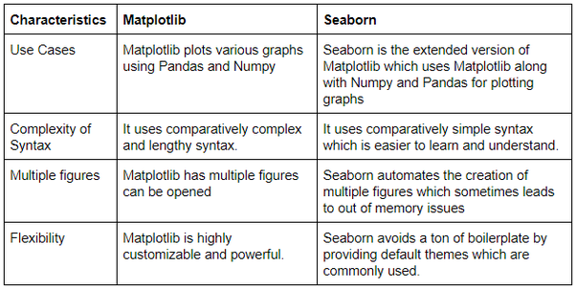
Seaborn vs Matplotlib

Slide 5
Important Features of Seaborn
Built in themes for styling matplotlib graphics
Visualizing univariate and bivariate data
Fitting in and visualizing linear regression models
Plotting statistical time series data
Seaborn works well with NumPy and Pandas data structures
It comes with built in themes for styling Matplotlib graphics

Slide 6
Installing Seaborn
pip install seaborn
conda install seaborn

Slide 7
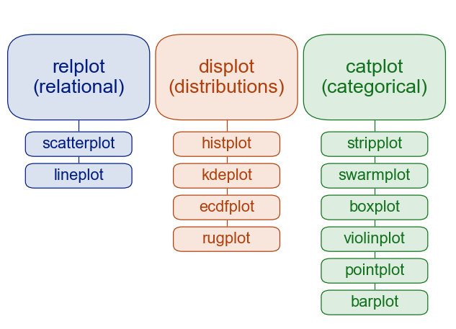
Figure-level vs. axes-level functions
https://seaborn.pydata.org/tutorial/function_overview.html

Slide 8
Types of Plot
Relational plots¶ - Understanding how the variables in the dataset relate each other and their relationships
Distribution plots - Suitable for comparing range and distribution for groups of numerical data Categorical plots - used for visualizing the relationship between variables. Those variables can be either be completely numerical or a category like a group, class or division
Regression plots - Creates a regression line between 2 parameters and helps to visualize their linear relationships
Matrix plots - A matrix plot is an array of scatterplots. effective when you are only interested in relationships among certain pairings of variables.

